Slide 1
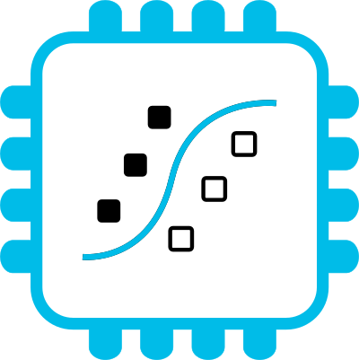



Embedding Data Science in IoT devices with MicroPython and emlearn
https://github.com/emlearn/emlearn-micropython
Jon Nordby <jononor@gmail.com>
EuroSciPy, Krakow, July 2026

Slide 2
Reminder
Tutorial: Developing IoT sensors with MicroPython
Wednesday 2026-07-22
11:00–12:30 @ Room 1.19
https://github.com/jonnor/micropython-iot-sensors-course

Slide 3
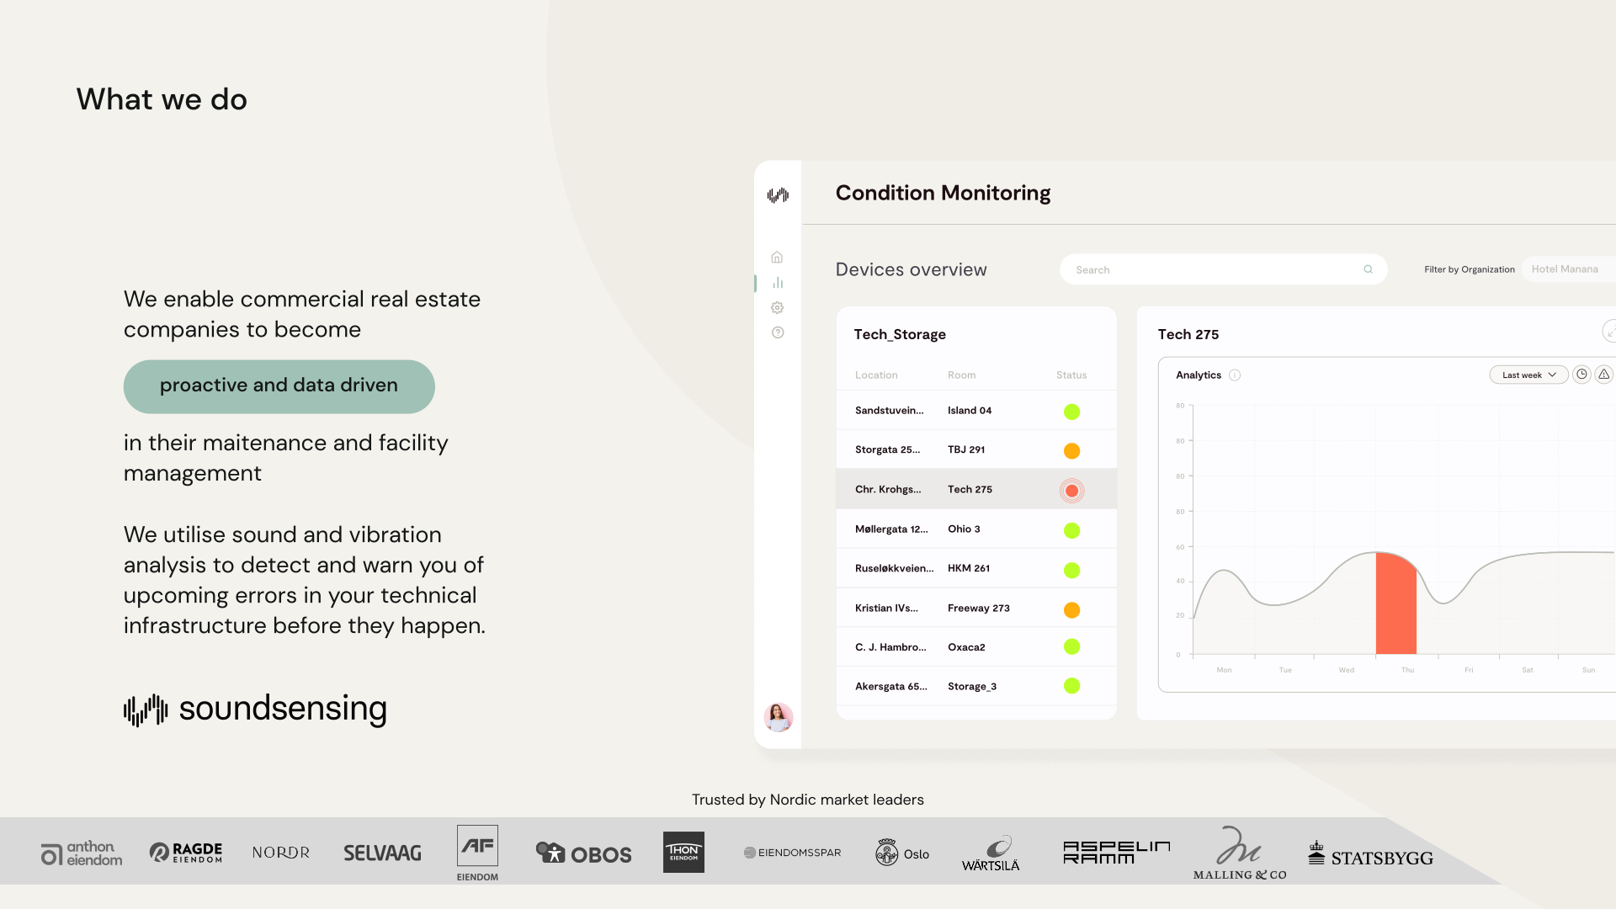
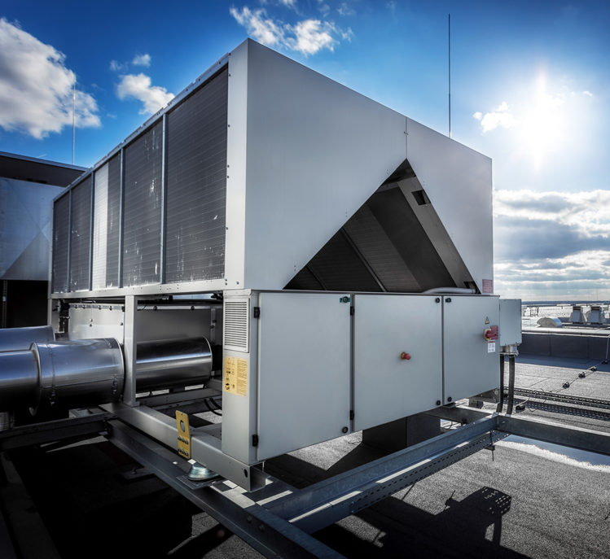
Notes:
Work as Head of Data Science at Soundsensing.
Soundsensing is a leading provider of predictive maintenance solutions for ventilation systems in buildings.
So we work a lot with sensor data. And also use Python as much as we can for Data Science, IoT and backend tasks.

Slide 4
Goal
You as a scientist, or an engineer supporting scientists,
become familiar with how to
create custom sensor systems
using microcontrollers and MicroPython,
including on-device data processing
like DSP and machine learning
using emlearn

Slide 5
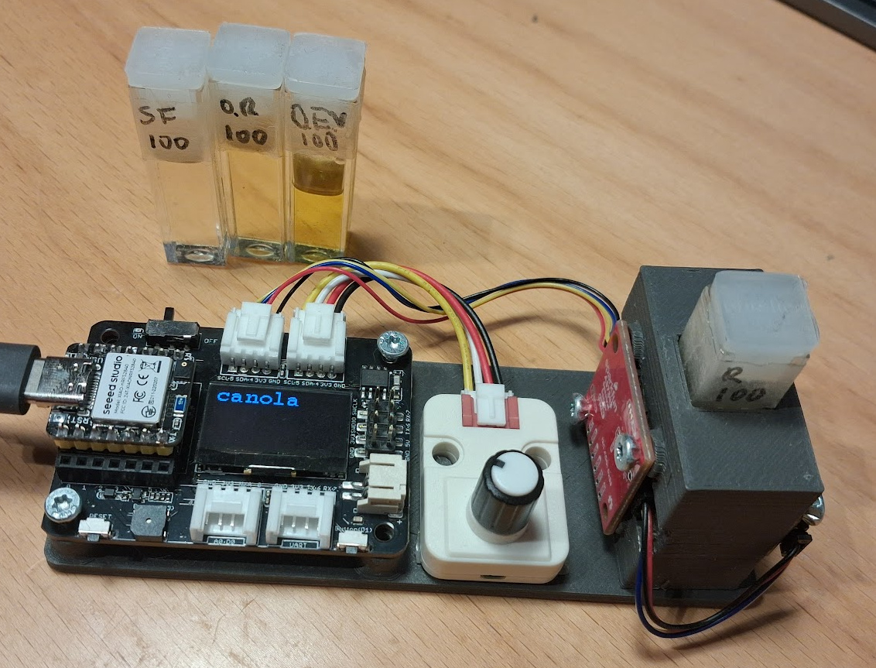
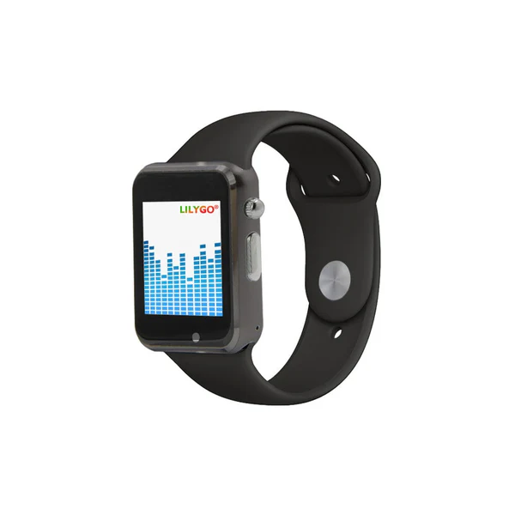
Motivating projects
Goal:
Make device that
actively support & encourage
data science workflows
(with Python)
Workflows
Capture data
Exploratory Data Analysis
Annotating data
Predictive modelling (classification/regression)
Acting on the data
Spectrometer
https://github.com/
jonnor/spectrometer
Activity Tracker
https://github.com/
jonnor/motion-machine

Slide 6
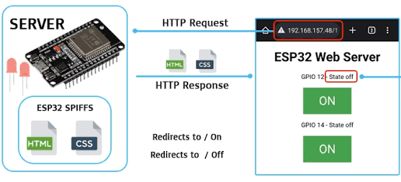
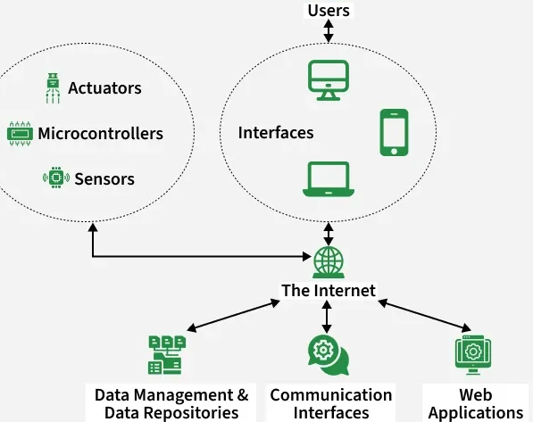
IoT system architectures
Cloud-based +
Wireless Sensor Networks
Standalone
Simple. Few system components
Low-cost. From 10 USD
Zero running/operating costs
Internet optional
! More resource constrained
Sensor data processing on microcontrollers with MicroPython (EuroSciPy 2025)
https://www.youtube.com/watch?v=VmVQu9cygMI

Slide 7
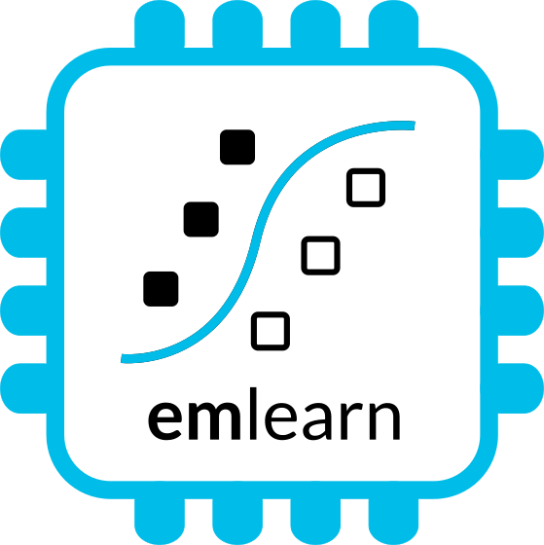
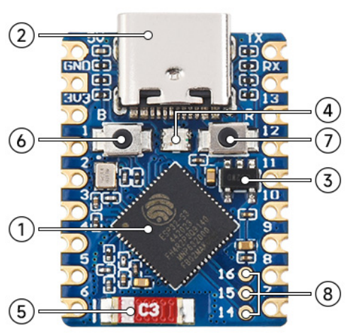
What is a microcontroller?
Modern microcontroller:
A complete programmable System-on-Chip
Example: ESP32-S3FH4R2
32 bit CPU, 240 Mhz
Floating Point Unit
2 MB RAM
4 MB FLASH
WiFi
Bluetooth Low Energy
USB-C
Espressif ESP32-S3FH4R2 chip: 2.5 USD
Waveshare ESP32-S3-Tiny board: 6 USD

Slide 8
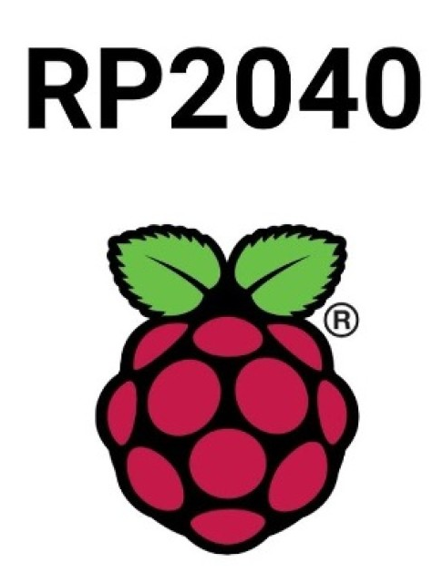

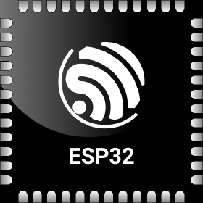

MicroPython - Introduction
MicroPython -
Python for microcontrollers and embedded linux (FOSDEM 2025)
https://www.youtube.com/watch?v=8Ao7DsTkpS4
Implements a subset of Python 3.x
For devices with 128 kB+ RAM
Supports 8+ microcontroller families directly,
many more via Zephyr RTOS
Mature - started in 2010
Official webpage: https://micropython.org
Notes:
STM32, Nordic NRF5x, ESP32, RP2040

Slide 9
MicroPython Data Science ecosystem
CPython
MicroPython
Tensorflow
scikit-learn
emlearn-micropython
github.com/emlearn/emlearn-micropython
OpenCV
OpenMV
https://openmv.io/
scipy
ulab
github.com/v923z/micropython-ulab
numpy
Libraries existing that implement a lot of embedded-relevant functionality from PyData stack.

Slide 10
emlearn for
MicroPython
A “scikit learn” for microcontrollers
https://github.com/
emlearn/emlearn-micropython

Slide 11
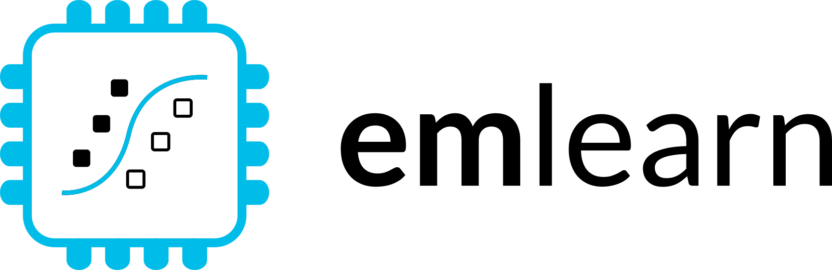





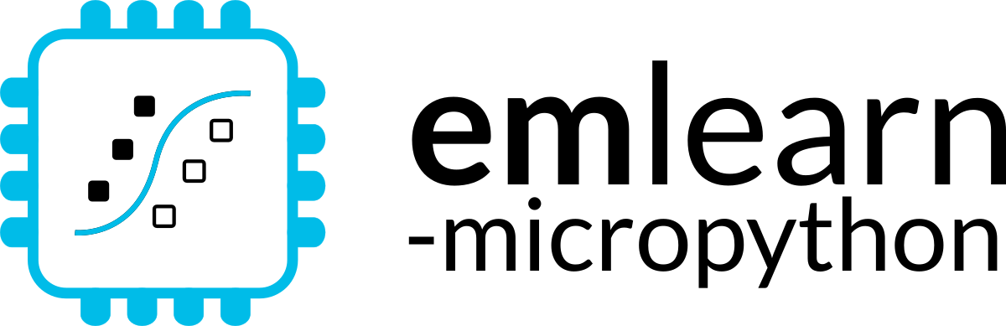




1. Train on PC
2. Deploy on device
pip install emlearn
Embedded Friendly
Portable C99 code
No dynamic allocations
Header-only
High test coverage
Integer/fixed-point math *
Small. 2 kB+ FLASH
Convenient training
Model creation in Python
Use standard libraries
  scikit-learn
  Keras
One-line to export to device
Verification tools included
Convenient & Efficient
Portable MicroPython
Single .mpy file
No dynamic allocations
High test coverage
Integer/fixed-point math *
Small. 2 kB+ FLASH
Notes:
emlearn is an open-source software library that can be used to implement such projects.
It provides embedded friendly implementations of Machine Learning models.
It supports converting models trained in Python.
Can either use scikit-learn or Keras.
The code is portable and clean C99.
It can be used on even the smallest MCUs,
as it does not need FPU, and the code size is very small.

Slide 12
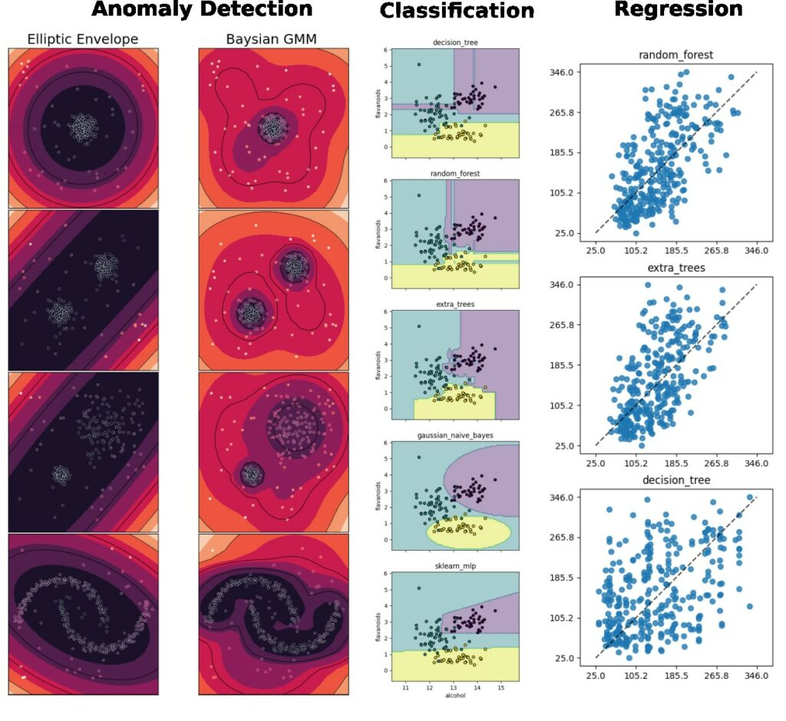
Supported tasks
Supports the most common tasks
for embedded
& sensor data use cases.
Classification
Regression
Anomaly Detection
Notes:
emlearn supports the three most common ML tasks:
classification, regression, anomaly detection.

Slide 13
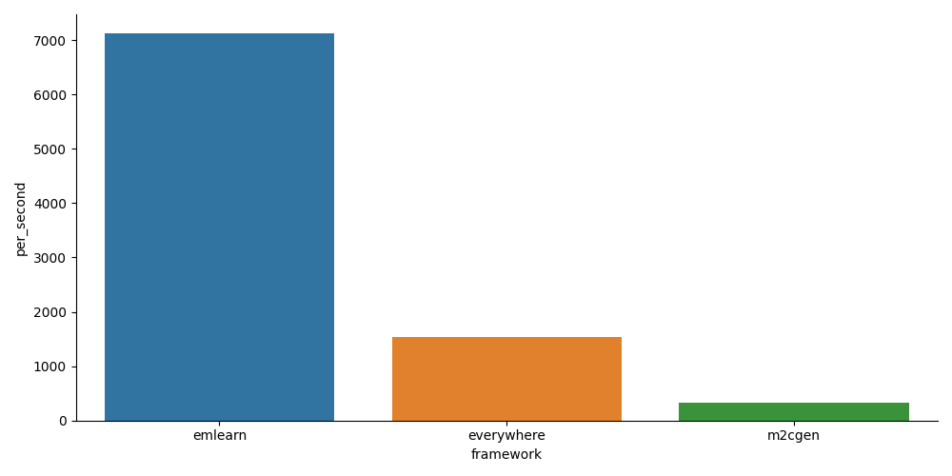
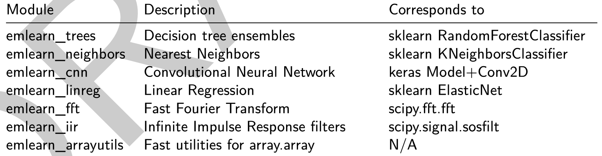
emlearn-micropython:
MicroPython bindings for emlearn
https://github.com/emlearn/emlearn-micropython/
5x - 20x faster
than plain Python
Modules installable at runtime (.mpy)
1 - 10 kB in size
PyData friendly

Slide 14
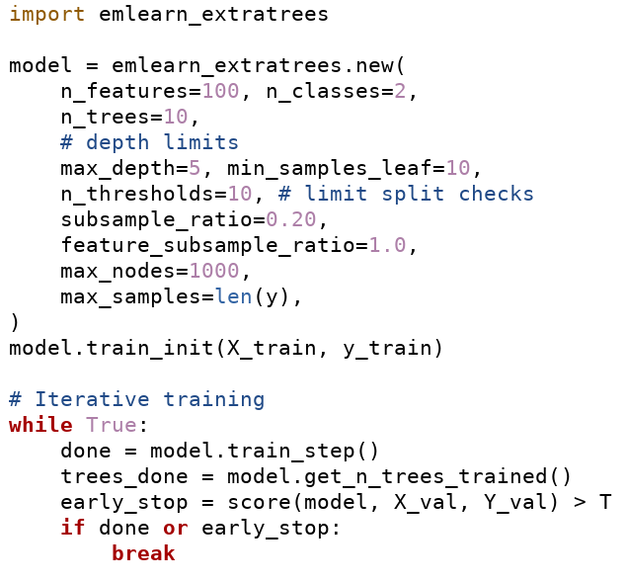
Training models using emlearn-micropython
Supported since April 2026
Designed for low RAM. From 10-100 kB
Iterative training
Tested on device. Mostly ESP32
Classification
emlearn_extratrees: Extremely Randomized Trees
emlearn_logreg: Logistic Regression
Regression
emlearn_linreg: Linear Regression
emlearn_plsr: Partial Least Squares Regression

Slide 15
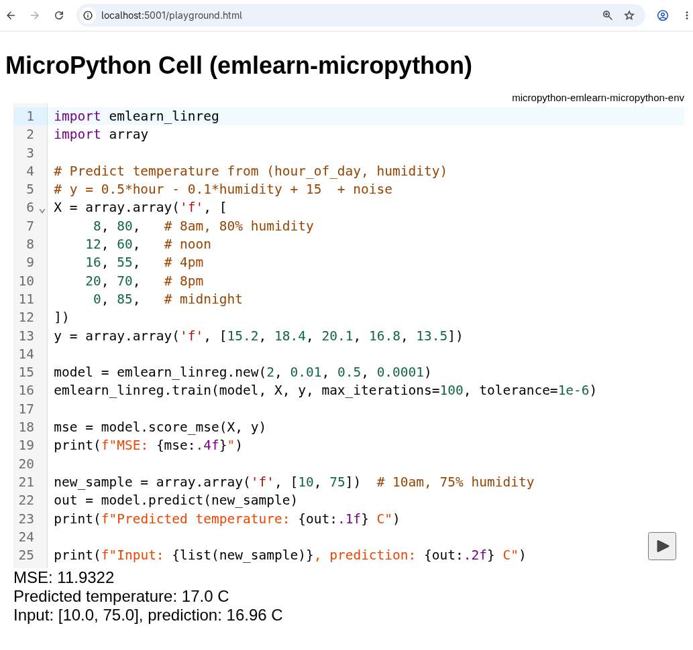
Browser support in emlearn-micropython
Supported since May 2026 (0.11.1)
Run models/pipelines client-side browser
For training or interactive analysis
Powered by WebAssembly + PyScript
700 kB bundle. Includes MicroPython!
Can be served directly from device
Documentation:
https://emlearn-micropython.readthedocs.io/en/latest/getting_started_browser.html#

Slide 16
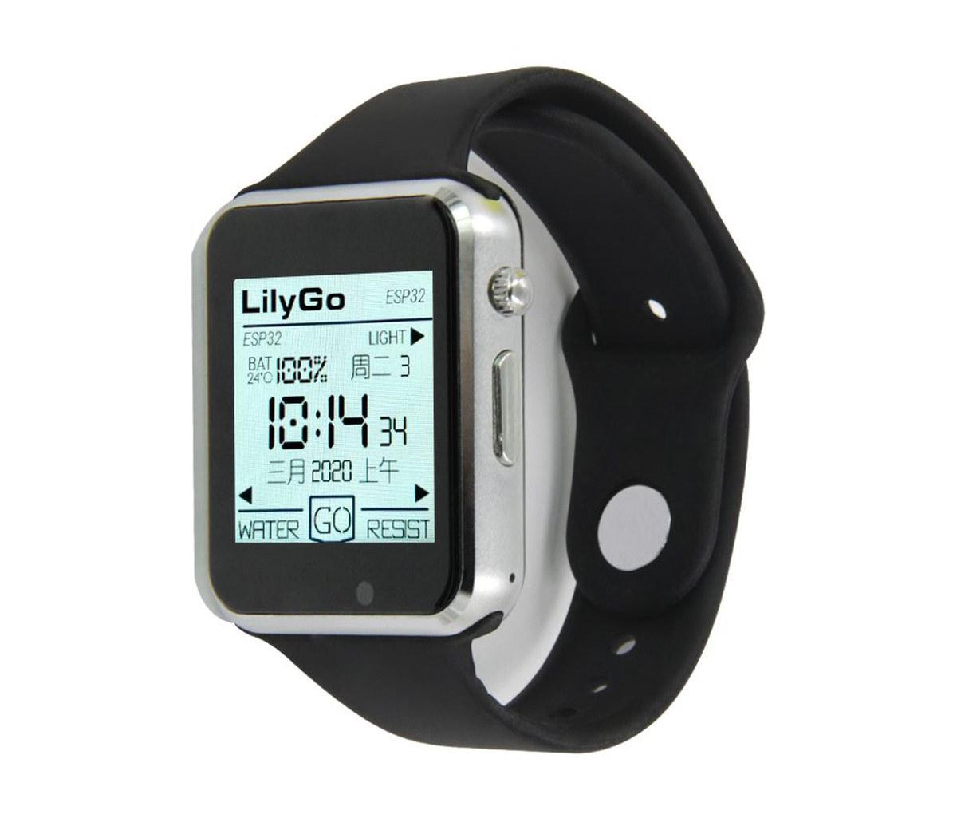
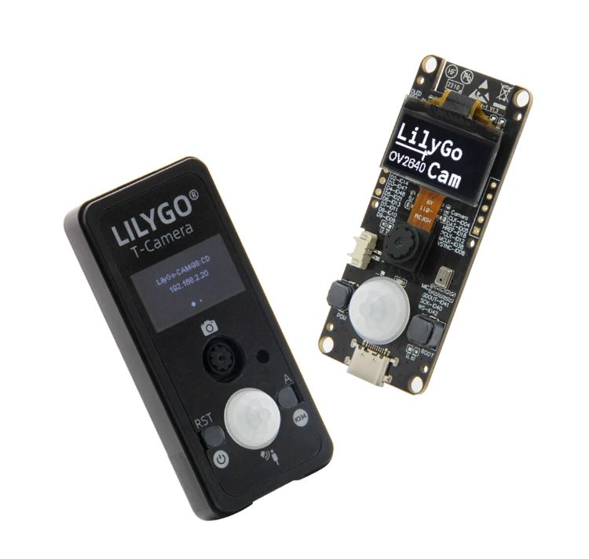
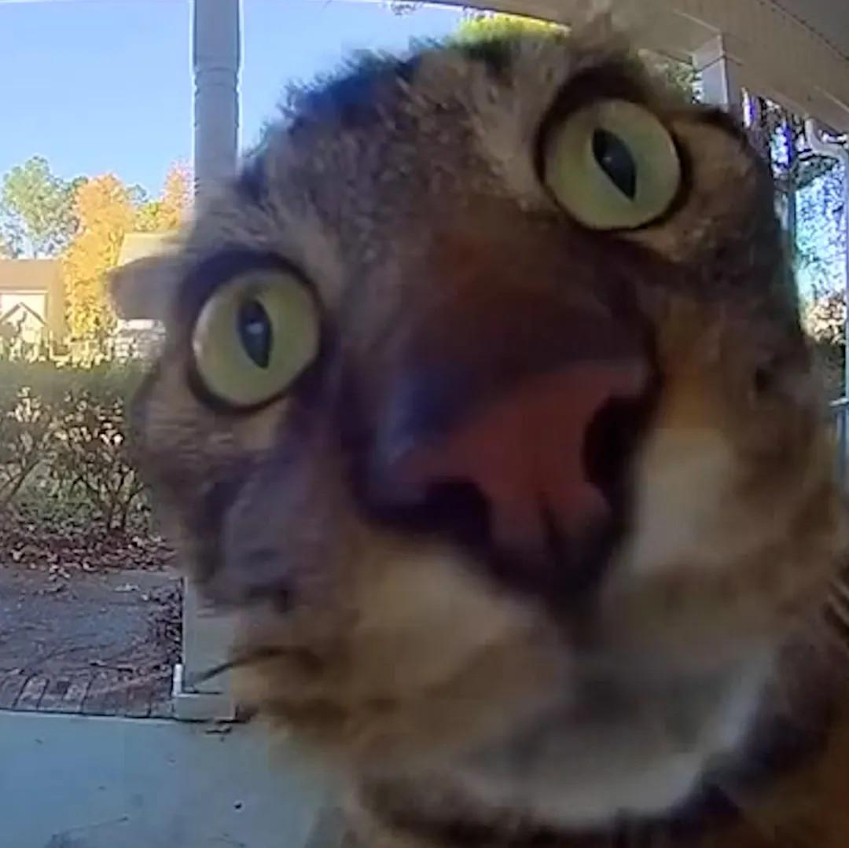
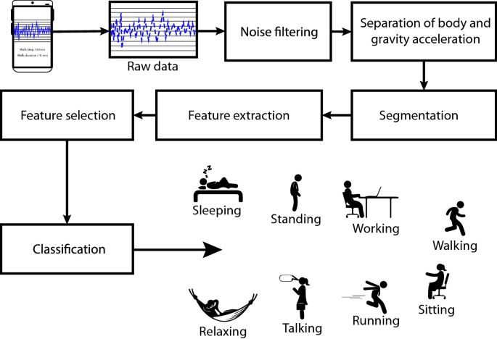
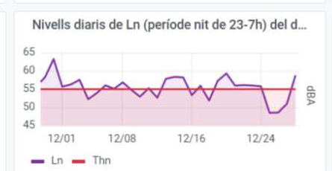
Activity tracker
Noise monitor
Image
Classifier
Examples at
https://github.com
/emlearn/emlearn-micropython
#examples
Accelerometer
Microphone
Camera
if is_MyCat(img):
open_door()
Random Forest classifier
emlearn_trees
Infinite Impulse Response filters
emlearn_iir
Convolutional Neural Network
emlearn_cnn

Slide 17
Case:
Spectrometer
https://github.com/
jonnor/spectrometer

Slide 18
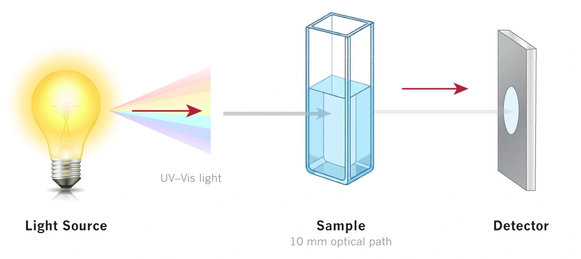
Absorption Spectroscopy
Which light did not pass through?
Absorbed spectra =
Reference spectra (no sample)
- Sample spectra

Slide 19
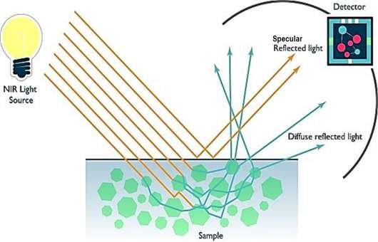
Reflectance Spectroscopy
What is the spectrum of reflected light?

Slide 20
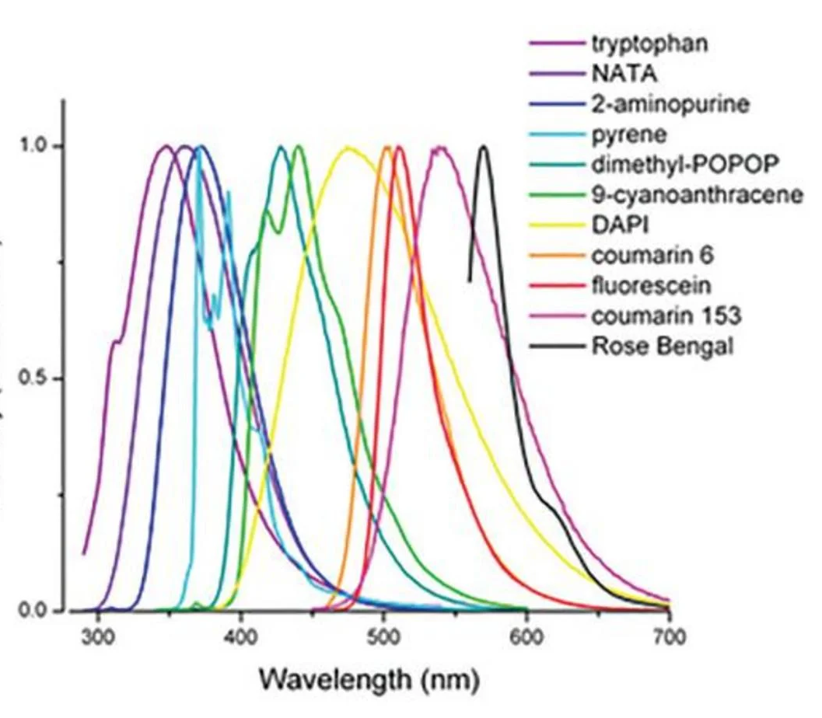
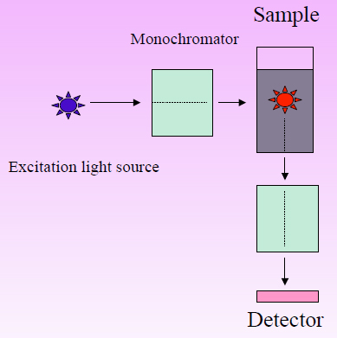
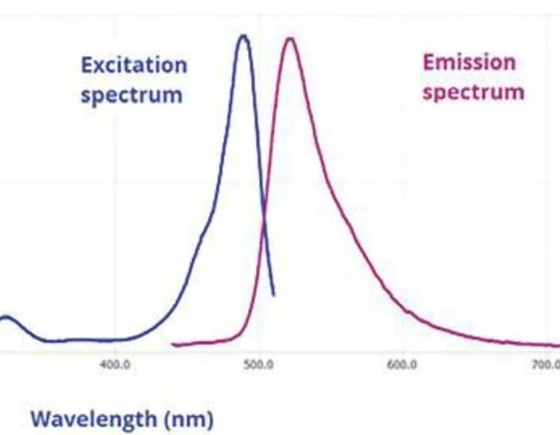
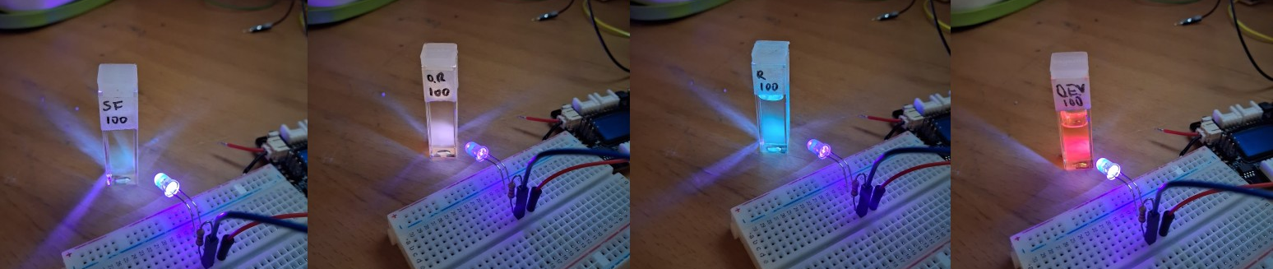
Fluorescence Spectroscopy

Slide 21
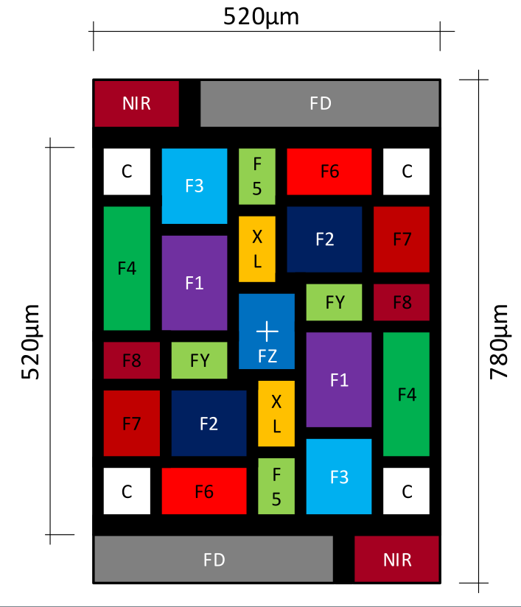
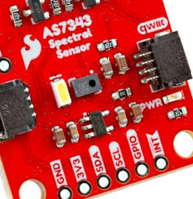
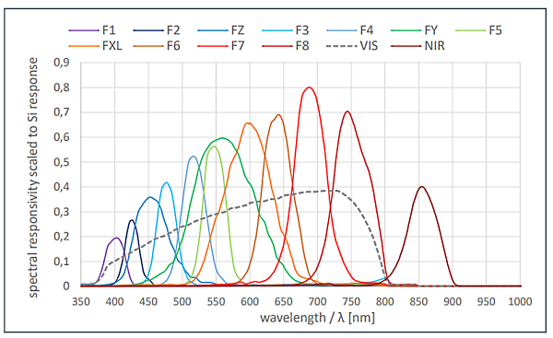
Hardware
ams AS7343 Spectral Sensor
14 channels (11 narrowband)
50-100 nm width per band
Visible + Near Infrared (NIR)
25 USD breakout
6 USD chip @ 1k units
For 10 mm cuvettes
3d-printed cuvette holder
Reflectance: White LED
Fluorescence: 405 nm UV LED
(Absorption: TODO)
https://ams-osram.com/products/sensor-solutions/ambient-light-color-spectral-proximity-sensors/ams-as7343-spectral-sensor

Slide 22
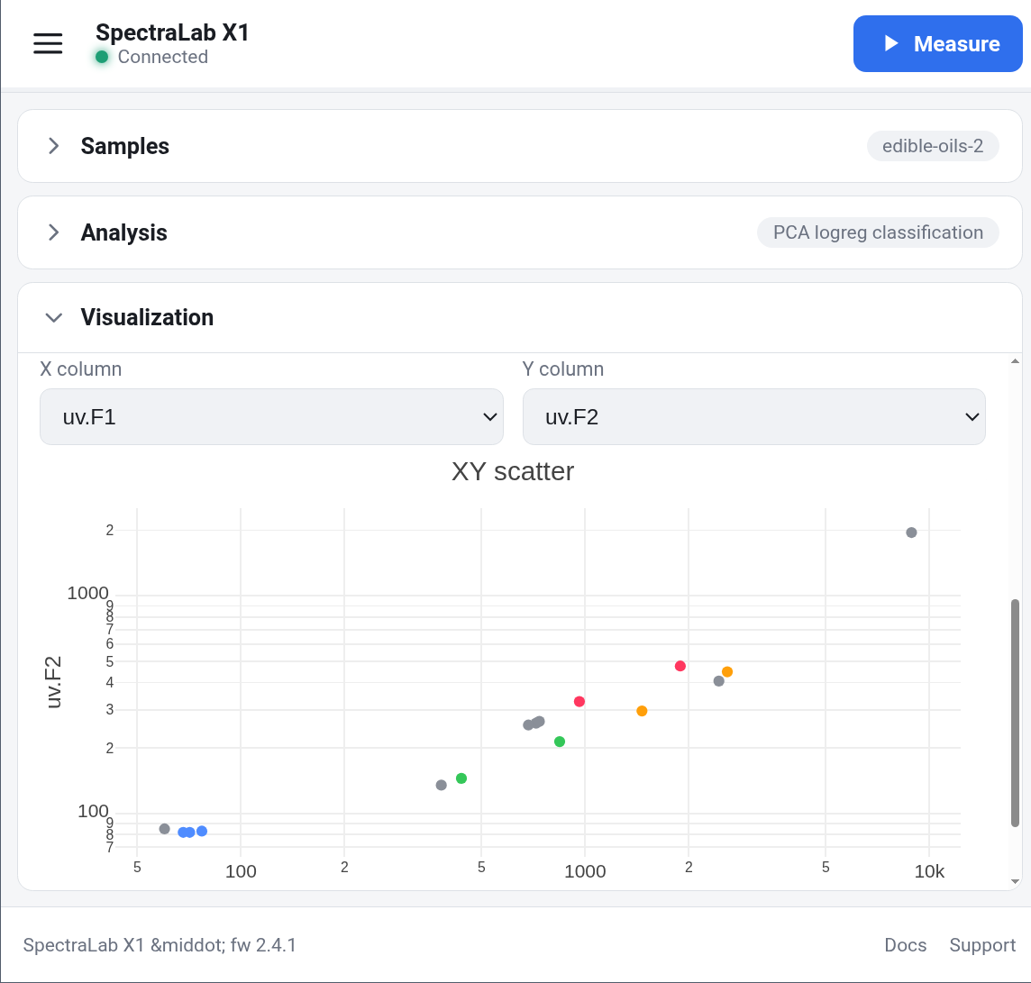
Software stack
Backend (device)
MicroPython
emlearn-micropython for PCA + logreg
micropython-npyfile for .npy files
MicroDot for web server
Frontend (browser/UI)
Plotly for plotting. Minimal: 350 kB
Preact for JavaScript UI
https://github.com/jonnor/spectrometer

Slide 23
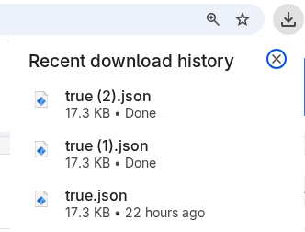
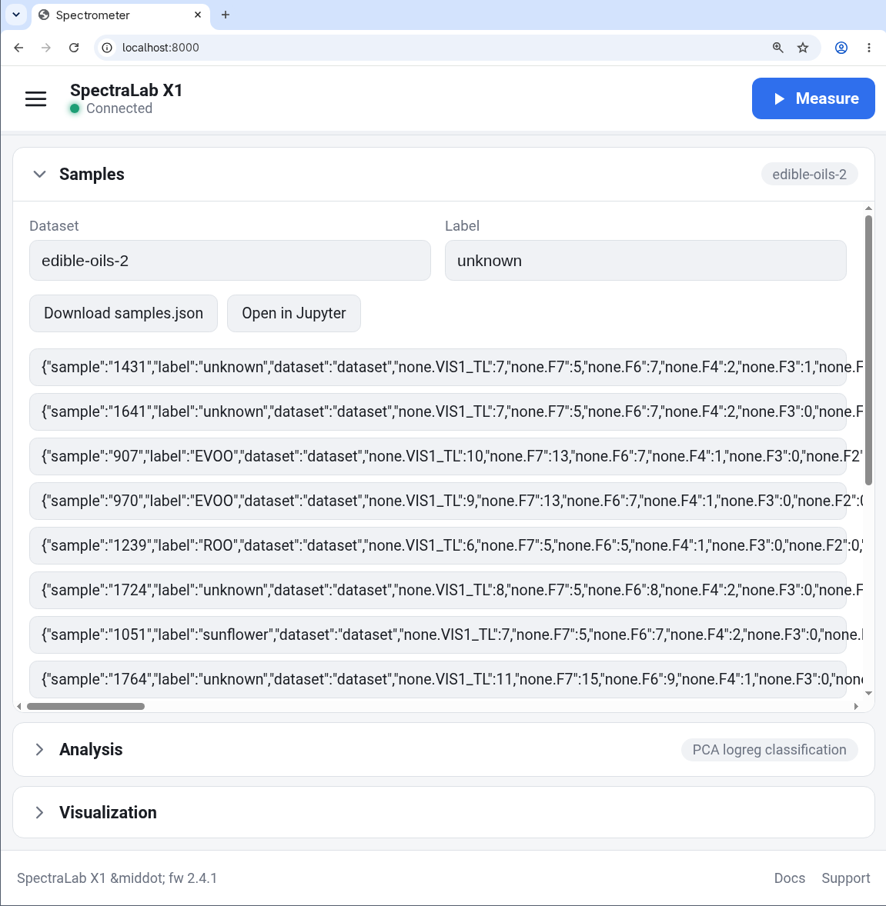
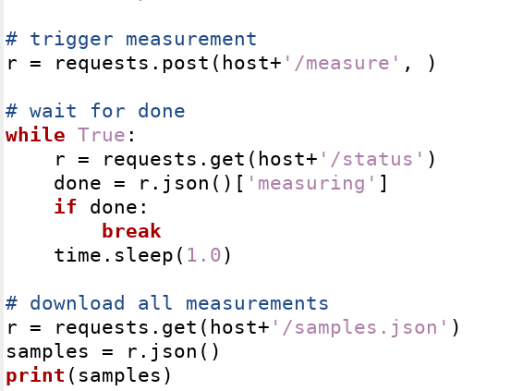
Data download & API integration
Use device programmatically
from Python (on PC)
via HTTP API

Slide 24
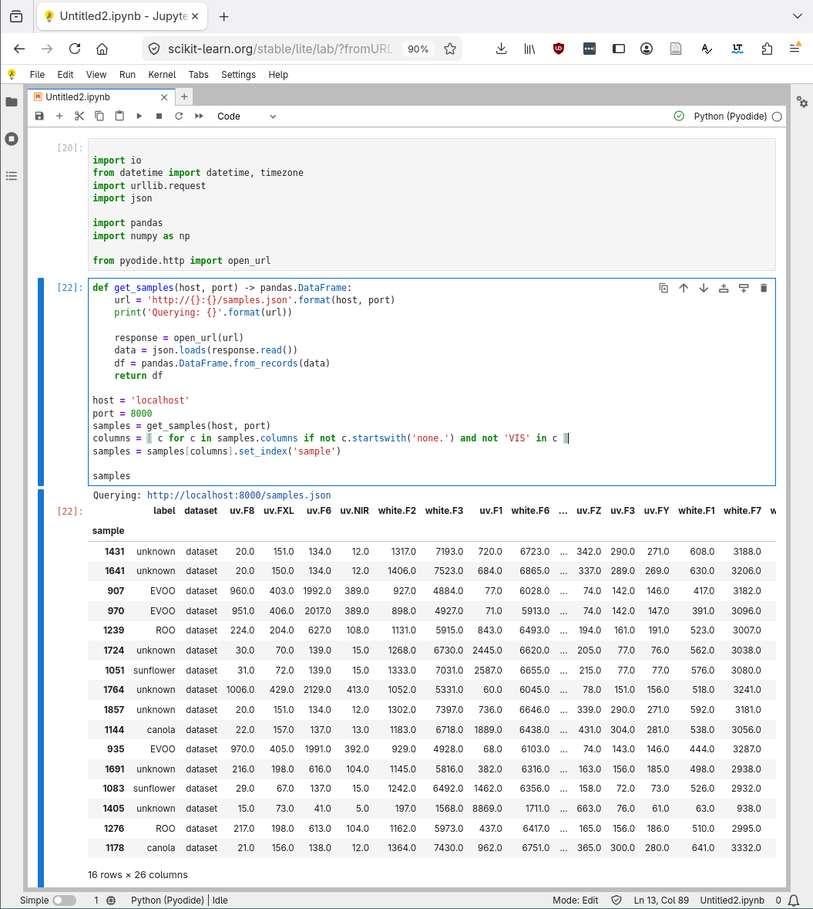
Jupyter Lite integration
https://scikit-learn.org/stable/lite/lab/?
fromURL=http://10.13.37.100:8000/static/notebook.ipynb
Load device data via HTTP API

Slide 25
Case:
Activity Tracker
https://github.com/
jonnor/motion-machine/

Slide 26
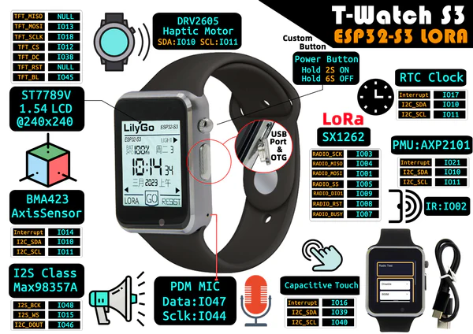
The hardware
LilyGo T-Watch S3
ESP32-S3 microcontroller
- 16 MB FLASH
- 16 MB RAM
- WiFi + BLE
- 3-axis accelerometer

Slide 27
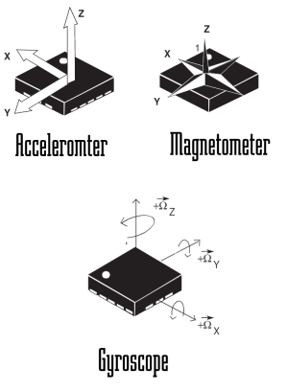
Activity tracker - processing pipeline
har_trees - emlearn-micropython example
https://github.com/emlearn/
emlearn-micropython/
tree/master/examples/har_trees
Machine Learning on Microcontrollers With Zephyr and emlearn (Open Source Summit 2025)
https://www.youtube.com/
watch?v=vBiji9IFJJs

Slide 28
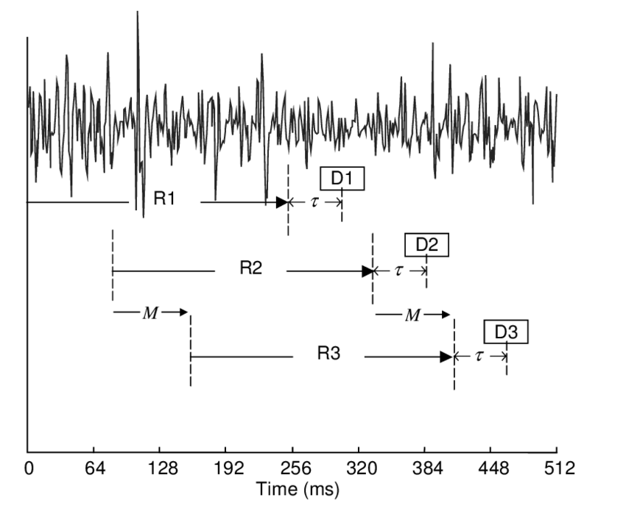
ML on streams: Continuous classification
Example config
- 4 second window, every 1 second
- 100 Hz samplerate / 10 ms sample interval
- Window processing budget: 60 ms
Preprocess
Model
Raw sensor data
Features
Class
[ x1 y1 z1
x2 y2 z2
…. ]
[ 42, 4002, … , 329 ]
“Jumping Jacks”
Notes:
The sensor data steam is conceptually infinite
The Machine Learning models on the other hand must have finite and fixed-length inputs
This is done by splitting the stream at fixed intervals of time.
Into windows
Usually with some overlap. So model gets multiple chances at predicting the same phenomena

Slide 29
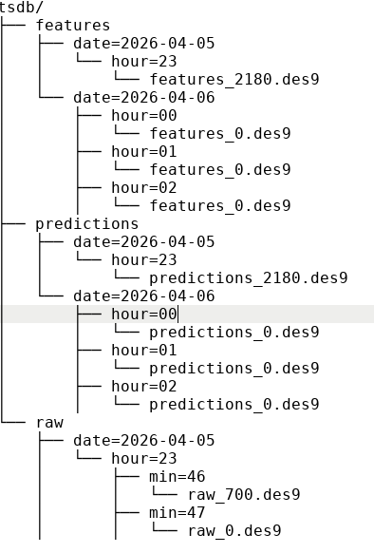
micropython-tsdb: time-series database on device
Features
Stores to disk using Python file API
Apache Hive-style partitioning
Row-based or columnar chunks
Time-series aware compression
(delta-encoding + Simple9b)
Repository:
https://github.com/jonnor/micropython-tsdb

Slide 30
Time-series data storage on device - performance
Query performance on ESP32S3 with internal FLASH
Reading 0.10 - 0.25 MB/second ~100k datapoints
  2 hours of 1 second resolution data, 10 columns
  1 year of 1 hour resolution data, 10 columns
IO / filesystem bound
Compression
Tested on raw accelerometer data (PAMAP2 dataset)
!! only 5% net savings - high entropy
Expecting 2x+ on ML features and predictions (quantized)
24 hours
3-axis accelerometer at 25 Hz int16
= 12.96 MB
Possible but tight
on 16 MB total space.
1 MB other timeseries
1 MB MicroPython fw
1 MB frontend
Repository:
https://github.com/jonnor/micropython-tsdb

Slide 31
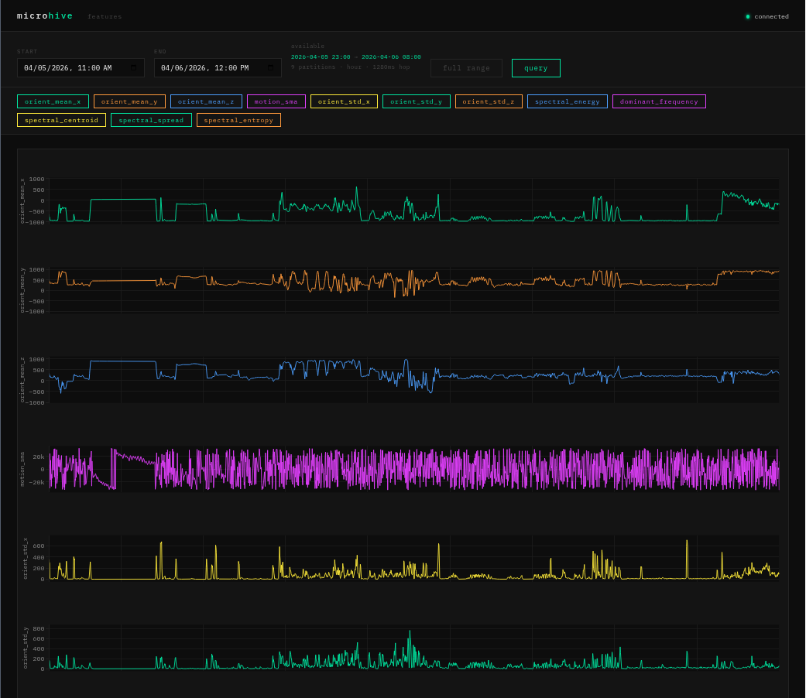
Web interface
WIP

Slide 32
Pushing data via HTTP or MQTT
Recommendation:
Keep the data to send in an in-memory queue
Only remove from queue after successful send
Implement timeout to handle WiFi/network/server problems
HTTP
Most common general protocol
Ex: notification to Slack, etc
MicroPython aiohttp no timeouts!! :(
MQTT
Most common IoT protocol.
Ex: data ingestion to IoT platforms
https://github.com/micropython/micropython-lib/blob/master/micropython/umqtt.simple/umqtt/simple.py
https://docs.micropython.org/en/latest/library/socket.html

Slide 33
Outro

Slide 34
Summary
MicroPython allows making custom sensors
MicroPython on microcontroller scales down to 10 USD hardware
emlearn-micropython enables DSP and ML models in MicroPython
Both inference and learning
MicroPython and emlearn-micropython can also run in the browser. Interactive data analysis, training pipelines, etc
Using WiFi + webui + on-device storage
allows building standalone measurement devices
with optional integration with other systems

Slide 35
Call to Action
Tutorial: Developing IoT sensors with MicroPython
Wednesday 2026-07-22
11:00–12:30 @ Room 1.19
https://github.com/jonnor/micropython-iot-sensors-course

Slide 36
Embedding Data Science in IoT devices with MicroPython and emlearn
https://github.com/emlearn/emlearn-micropython
Jon Nordby <jononor@gmail.com>
EuroSciPy, Krakow, April 2026

Slide 37
Bonus

Slide 38
Made with emlearn

Slide 39
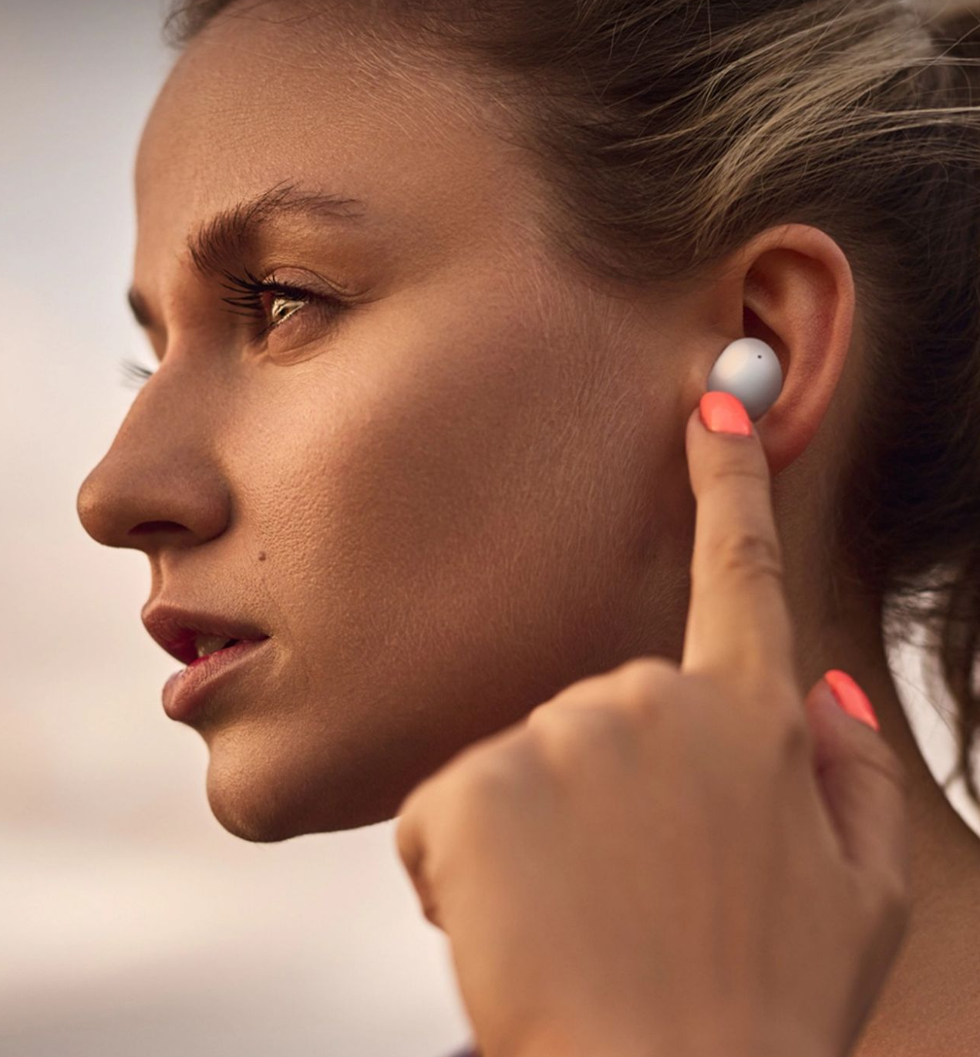
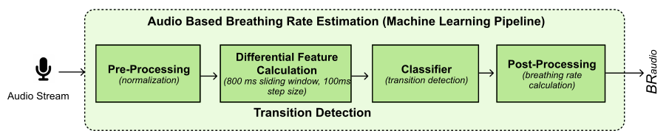
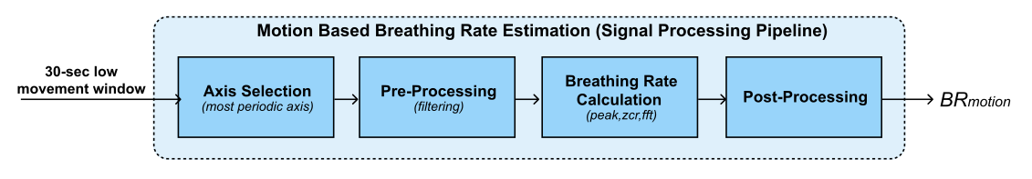
Health monitoring earable
Breathing rate is critical to monitor for persons with respiratory health problems.
Monitoring for every-day use, not just in clinical context. Using earable to replace specialized devices.
Random Forest classifier for audio.
Remote Breathing Rate Tracking in Stationary Position
Using the Motion and Acoustic Sensors of Earables
Tousif Ahmed et.al (2023)
Notes:
The project was started in 2018 by me.
And has been maintained by me since that time. With a couple of contributors here and there.
Quite mature. Has been used for dozens of projects across the world.

Slide 40
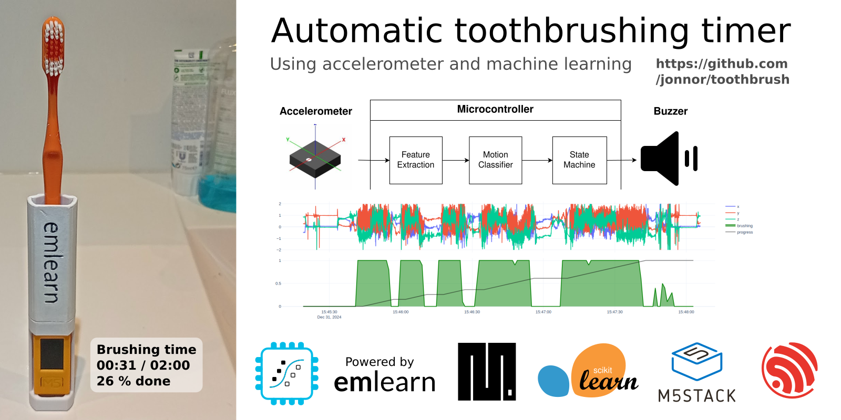
Automatic toothbrush timer
https://github.com/
jonnor/toothbrush/
Stock hardware: M5StickC PLUS 2 by M5Stack
~500 lines of MicroPython code
Collected and labeled data in ~1 hour
Data collection and training tools:
https://github.com/emlearn/emlearn-micropython/tree/master/examples/har_trees

Slide 41

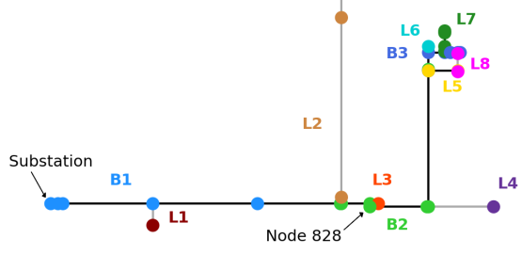
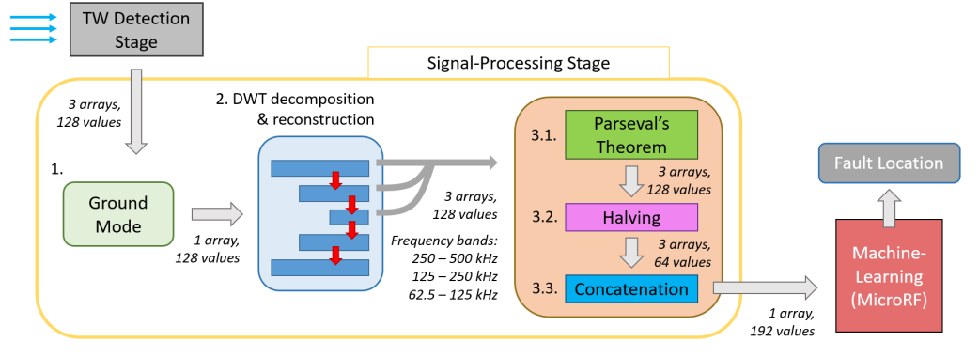

Electric grid monitoring
Detect and localize faults in the electric grid.
Analyzes the voltage signals at a single location.
Able to detect where the fault originated.
Runs on a DSP board from Texas Instruments.
Micro Random Forest: A Local, High-Speed Implementation of a Machine-Learning Fault Location Method for Distribution Power Systems
Tousif Ahmed et.al (2023)
Notes:
The project was started in 2018 by me.
And has been maintained by me since that time. With a couple of contributors here and there.
Quite mature. Has been used for dozens of projects across the world.

Slide 42
Tree model optimization
https://emlearn.readthedocs.io/en/latest/model_optimization.html
https://emlearn.readthedocs.io/en/latest/tree_based_models.html

Slide 43
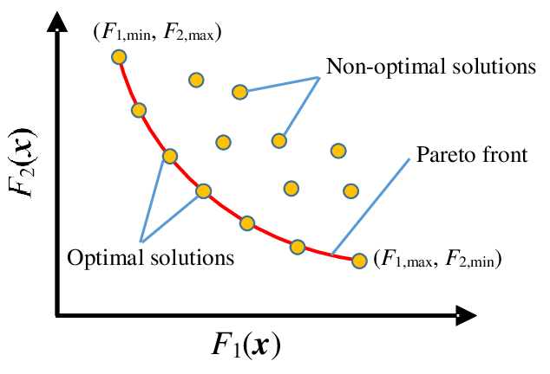
Pareto front - performance/compute tradeoffs
Many possible combinations of predictive performance vs computational cost
No point considering the non-optimal solutions!
Pareto front is formed by the set of optimal solutions - that dominate the non-optimal ones
Describes the possible tradeoffs between predictive performance and compute
Utilities for finding Pareto front in emlearn.evaluate.pareto https://emlearn.readthedocs.io/en/latest/evaluate.html
Example: https://emlearn.readthedocs.io/en/latest/auto_examples/trees_hyperparameters.html
Notes:
Inline and loadable (data structure)
Majority voting instead of class probabilities
Leaf-node de-duplication

Slide 44
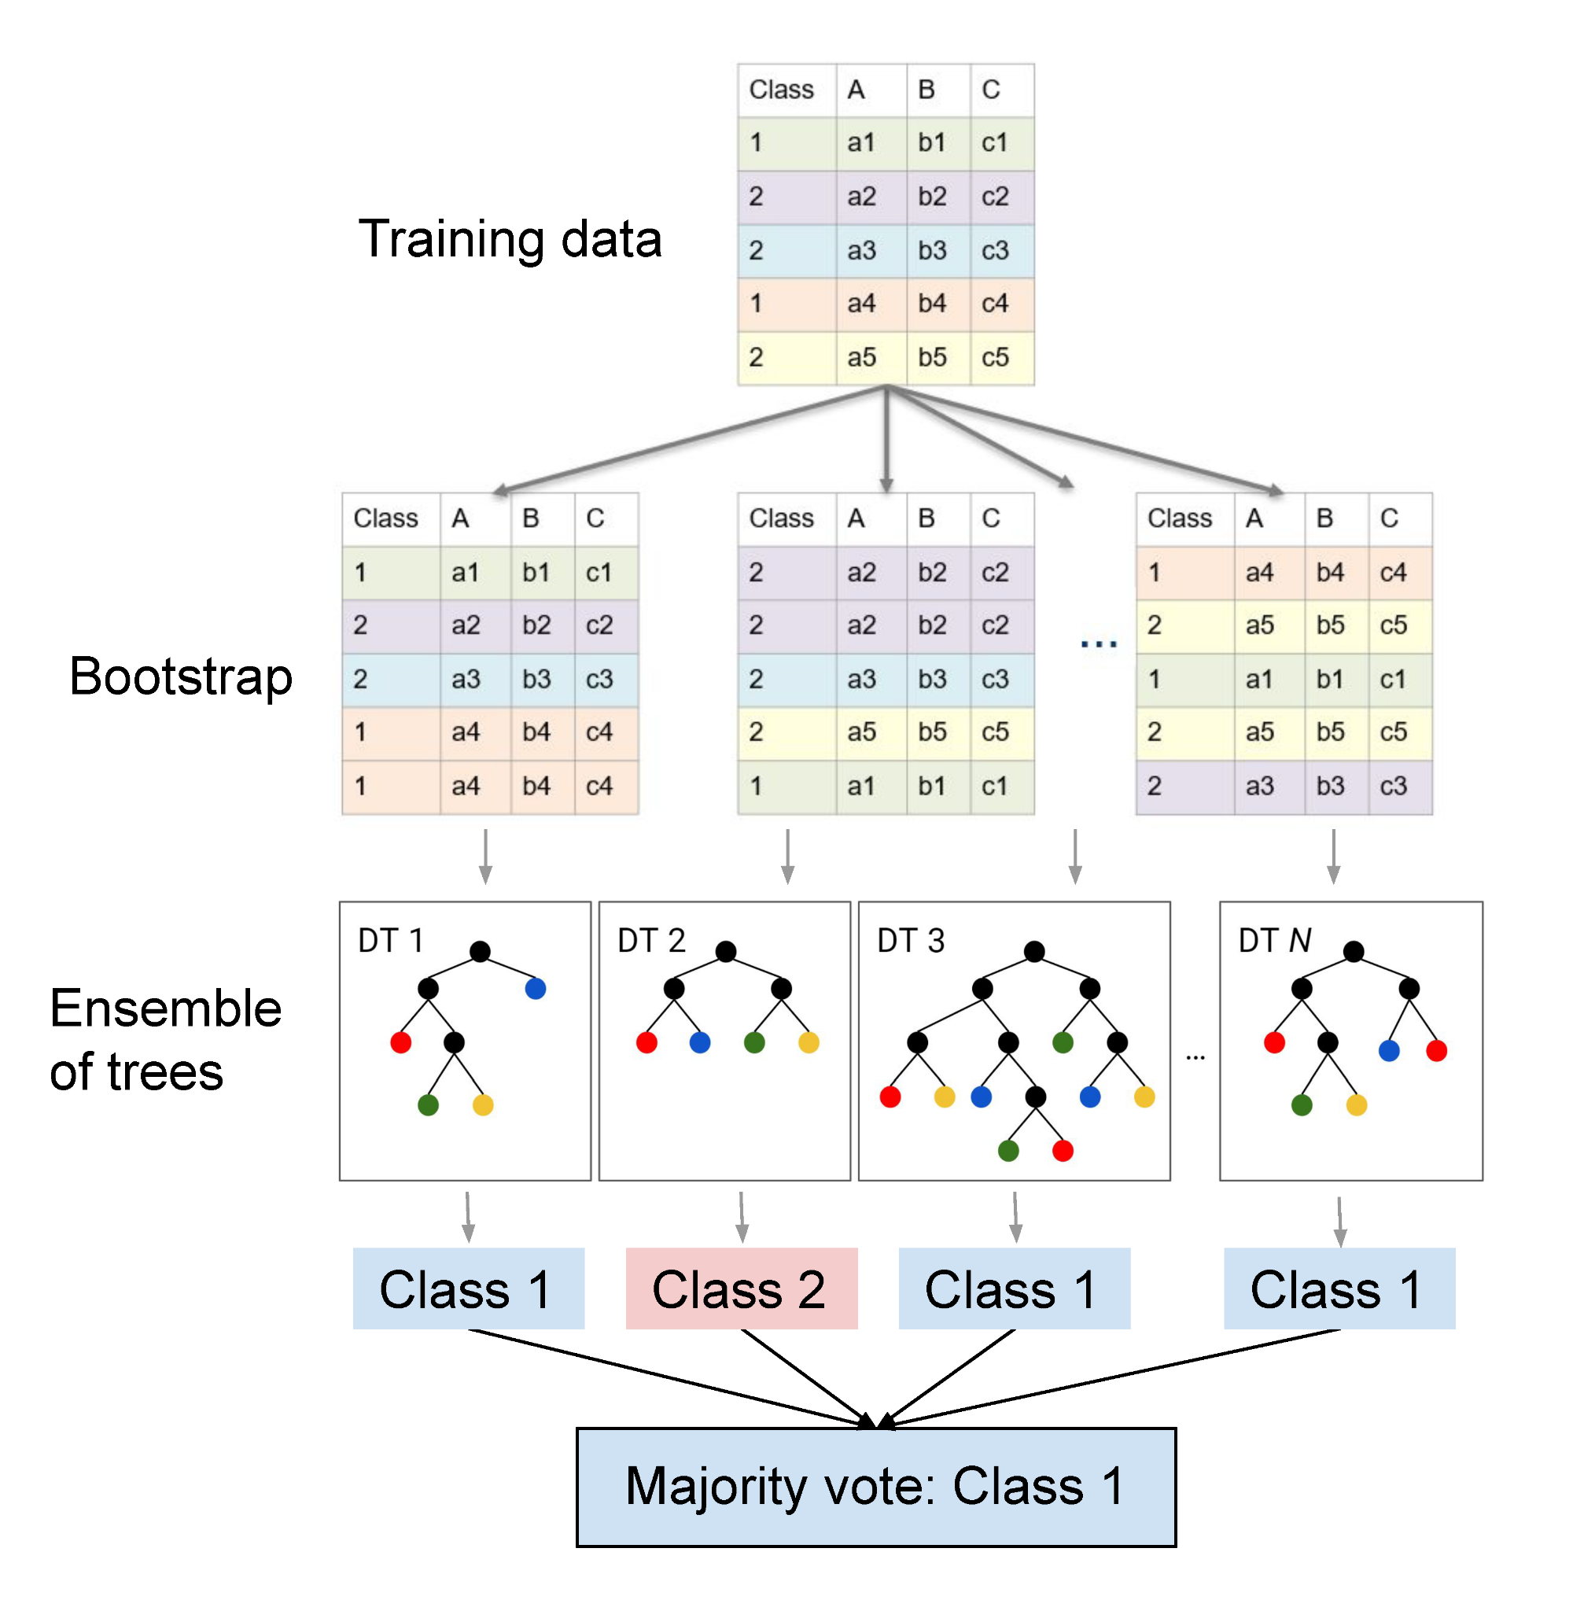

How tree-ensemble models work

Slide 45

Tree-based ensembles - costs
Input features, length F
[ 0.23, 0.56, 0.11, 0.55 ]
IF features[2] < 0.74
THEN next=left
ELSE next=right
Depth
D
Tree 1
Tree 2
No. features F [0]
No. trees T
Tree Depth D_max [1] / D_eff [2]
No. nodes N ≈ T * (2 ** D)
Computational costs
Memory (RAM) O(F)
Program (FLASH) O(N) [3]
Exc. time (CPU) sum(D_eff(t), t -> T)
[0] May also enable deeper trees
[1] Depth might differ across trees
[2] Execution path is data dependent! Can estimate average using a dataset, or worst-case from model
[3] Assuming leaf and decision nodes same size
cl1
cl2
Utilities for estimating costs
from emlearn.evaluate.trees import
model_size_bytes,
compute_cost_estimate
Notes:
Inline and loadable (data structure)
Majority voting instead of class probabilities
Leaf-node de-duplication

Slide 46

Tree-based ensemble - predictive performance
No. features F increases capacity
No. trees T increases capacity, decreases overfitting
Tree Depth D_max / D_eff increases capacity, increases overfitting
No. nodes N ≈ T * D
For generalized performance (on unseen data), need to balance overfitting.
Notes:
Inline and loadable (data structure)
Majority voting instead of class probabilities
Leaf-node de-duplication

Slide 47

Hyperparameter tuning with scikit-learn
Vary n_estimators (trees)
and one of the depth limiting hyperparameters
from sklearn.model_selection import GridSearchCV, RandomizedSearchCV
https://emlearn.readthedocs.io/en/latest/auto_examples/trees_hyperparameters.html
Notes:
Inline and loadable (data structure)
Majority voting instead of class probabilities
Leaf-node de-duplication

Slide 48
Sensors with MicroPython

Slide 49
Compute constraints
RAM
64 kB
Reserved
FLASH
512 kB
Reserved
ML pipeline
Post-processing
Post-processing
Memory (RAM)
Program space (FLASH)
Inference time (CPU)
Energy (battery)
Model
Model
Pre-processing
Pre-processing
Sensor reading
Sensor reading
System/
Application
User interface
Drivers
Drivers
CPU
Cortex M4F
User interface
Connectivity
Connectivity
Active time
Send
Send
Sleep zzzzZZZ
Energy
Total time
Time
Notes:
Inline and loadable (data structure)
Majority voting instead of class probabilities
Leaf-node de-duplication

Slide 50

Temperature sensor
- code
1. Read the sensor in a loop
2. Send data using MQTT
3. Wait until next measurement
The same approach usable for other
slow-changing phenomena
Using https://viper-ide.org/ with Chromium
Zero-install. Connect to device via USB
Notes:
Temperature is a slow changing phenomena.
Want: 1 value for longish time interval
(ex: 5 min)
! Sensor can be noisy. Filtering advised
Will show analog sensor example.
Same approach can be used for a digital sensor.
And for other slow-changing phenomena.

Slide 51

Slow-changing phenomena
For slow-changing phenomena
(relative to measurement interval)
Sample, Send, Sleep
1. Read the sensor
2. Send data
3. Wait until next measurement
Processing
Sensor reading
Send
Water level measurement
Energy
Sleep zzzzZZZ
Time
Measurement interval
Active time
3 seconds
5 minutes
Notes:
Temperature is a slow changing phenomena.
Want: 1 value for longish time interval
(ex: 5 min)
! Sensor can be noisy. Filtering advised
Will show analog sensor example.
Same approach can be used for a digital sensor.
And for other slow-changing phenomena.

Slide 52

Continuous measurement
Health monitoring of cows
using accelerometer
Processing
Sensor reading
Send accelerometer data continuously
6 kB bytes/minute
Send
Power Efficient Wireless Sensor Node through Edge Intelligence
Abhishek Damle (2022)
Classify data using a Decision Tree
lying/walking/standing/grazing/ruminating
6 bytes / minute
Active time
Measurement interval

Slide 53




Act locally
Task:
Give vaccinated bait only to Tasmanian devils
Trigger: PIR sensor
Wake up
Classify image using CNN
if is_Taz:
dispense_bait()
Send event over LoRaWAN
EdgeAI bait dispenser to vaccinate
the Tasmanian devil (Sarcophilus harrisii)
against the devil facial tumour disease
Prithul Chaturvedi¹, Andrew S. Flies, et al.
Notes:
Make it moving again and again (loop it)

Slide 54
Activity Recognition
Using accelerometer / IMU

Slide 55
ML on streams: Continuous classification
The sensor data stream
is sliced into overlapping windows.
Each window processed independently
Preprocess
Model
Raw sensor data
Features
Class
[ x1 y1 z1
x2 y2 z2
…. ]
[ 42, 4002, … , 329 ]
“Jumping Jacks”
Notes:
The sensor data steam is conceptually infinite
The Machine Learning models on the other hand must have finite and fixed-length inputs
This is done by splitting the stream at fixed intervals of time.
Into windows
Usually with some overlap. So model gets multiple chances at predicting the same phenomena

Slide 56






Exercise tracker
Toothbrush timer
Health monitoring for cattle
Power Efficient Wireless Sensor Node through Edge Intelligence
Abhishek Damle (2022)
https://github.com/jonnor/toothbrush/

Slide 57
Activity Recognition usecases
Human Activity Recognition. Health, medical, sports
https://github.com/jonnor/embeddedml/blob/master/applications/human-activity-recognition.md
Animal Activity Recognition. Pets, livestock, wild animals
https://github.com/jonnor/embeddedml/blob/master/applications/animal-activity-recognition.md
Other TinyML tasks related to motion / IMUs
Gesture Recognition
https://github.com/jonnor/embeddedml/blob/master/applications/gesture-recognition.md
Condition Monitoring of Machinery
https://github.com/jonnor/condition-monitoring

Slide 58

Gravity separation
Simple: Low-pass accelerometer data
Gravity[3] = lowpass(Acceleration[3], 0.30 Hz, 4)
Motion[3] = Acceleration[3] - Gravity[3]
Implemented with eml_iir.h [1]
Advanced: Fusion of gyro + accelerometer
Complimentary filter, Madgewick, Mahoney, …
C code in Zephyr Scientific Library (zclib) [2]
https://github.com/emlearn/emlearn/tree/master/examples/motion_recognition
https://zephyrproject-rtos.github.io/zscilib/group___f_u_s_i_o_n___a_l_g_o_r_i_t_h_m_s.html

Slide 59

Spectral features using FFT
C / eml_fft.h https://github.com/emlearn/emlearn/tree/master/examples/motion_recognition
MicroPython / emlearn_fft.mpy https://github.com/emlearn/emlearn-micropython/blob/master/paper/example.py

Slide 60



har_trees - Machine Learning pipeline
Using a scikit-learn based pipeline.
# Setup subject-based cross validation
splitter = GroupShuffleSplit(n_splits=n_splits, test_size=0.25,
random_state=random_state)
# Random Forest classifier
clf = RandomForestClassifier(random_state = random_state,
n_jobs=1, class_weight = "balanced")
# Hyper-parameter search
search = GridSearchCV(clf, param_grid=hyperparameters,
scoring=metric, refit=metric, cv=splitter)
search.fit(X, Y, groups=groups)
import emlearn
converted = emlearn.convert(clf)
converted.save(name='gesture', format=’csv’, file='model.csv')
https://github.com/emlearn/emlearn-micropython/tree/master/examples/har_trees

Slide 61
emlearn-micropython: Install & Export model
import emlearn
estimator = train_model()
converted = emlearn.convert(estimator)
converted.save(name='gesture', format=’csv’, file='gesture_model.csv')
Export model on PC
Copy model to device
mpremote fs cp gesture_model.csv :
Install MicroPython library on device
mip install https://emlearn.github.io/...../xtensawin_6.2/emltrees.mpy
Prebuilt binary
No need to setup
C toolchain and SDK

Slide 62
emlearn-micropython: Load model & run
import emltrees
# Instantiate model. Capacity for trees, decision nodes, classes
model = emltrees.new(20, 200, 10)
# Load model "weights"
with open('gesture_model.csv') as f:
emltrees.load_model(model, f)
Load model on device
# Read sensor data
sensor.fifo_read(samples)
# Preprocess features
preprocessor.run(samples, features)
# Run model
out = model.predict(features)
Run inference

Slide 63
MicroPython tour

Slide 64
MicroPython - Introduction
Implements a subset of Python 3.x
For devices with 128 kB+ RAM
Supports 8+ microcontroller families directly,
many more via Zephyr RTOS
Official webpage: https://micropython.org
Notes:
STM32, Nordic NRF5x, ESP32, RP2040

Slide 65


MicroPython - Installing
Download prebuilt firmware
https://micropython.org/download/?port=esp32
Flash firmware to device
pip install esptool
esptool.py --chip esp32 --port … erase_flash
esptool.py --chip esp32 --port … write_flash -z 0 micropython-v1.17.bin
Connect to device
pip install mpremote
mpremote repl
IDE (optional): Thonny, VS Code, et.c.
Notes:
! drives for peripherals that are on a board not included in core firmware
Will likely need to hunt a bit for each sensor, screen etc

Slide 66
MicroPython is Python - but not CPython
High degree of compatibility - but never 100%
Continuous job to keep up with CPython
Some differences inherent - from < 1 MB RAM and FLASH
Included libraries are minimal
micropython-lib has more extensive/featured
https://github.com/micropython/micropython-lib
Known incompatibilities
https://docs.micropython.org/en/latest/genrst/index.html
#micropython-differences-from-cpython
Not implemented (by CPython major release)
https://github.com/micropython/micropython/issues/
7919#issuecomment-1025221807
No CFFI or C module compatibility!
But there is another C API
=> No standard PyData stack
But there are alternatives
Notes:
Temperature is a slow changing phenomena.
Want: 1 value for longish time interval
(ex: 5 min)
! Sensor can be noisy. Filtering advised
Will show analog sensor example.
Same approach can be used for a digital sensor.
And for other slow-changing phenomena.

Slide 67


Hardware access - the machine module
https://docs.micropython.org/en/latest/library/machine.html
Hardware Abstraction Layer
for microcontroller peripherals
Same on all hardware/ports
* with exceptions

Slide 68





Connectivity
WiFi
network.WLAN
Ethernet
network.LAN
BLE - Bluetooth Low Energy
aioble - high-level application API, asyncio
bluetooth - low-level hardware-layer
Cellular (4G / LTE)
network.PPP
LoRa / LoRaWAN
micropython-lib: lora
Notes:
Temperature is a slow changing phenomena.
Want: 1 value for longish time interval
(ex: 5 min)
! Sensor can be noisy. Filtering advised
Will show analog sensor example.
Same approach can be used for a digital sensor.
And for other slow-changing phenomena.

Slide 69
mpremote
File system
Enabled on most ports/hardware
(with sufficient resources)
Internal FLASH and/or SDCard
LittleFS or FAT32
Save/load from standard files [1]
https://docs.micropython.org
/en/latest/reference/filesystem.html
Tool for PC <-> microcontroller communication
https://docs.micropython.org
/en/latest/reference/mpremote.html
Copy from device
mpremote cp -r :images/ ./data/
Copy to device
mpremote cp ./model.trees.csv ./models/
1. Using micropython-npyfile to read/write Numpy .npy files
https://github.com/jonnor/micropython-npyfile/
Notes:
Temperature is a slow changing phenomena.
Want: 1 value for longish time interval
(ex: 5 min)
! Sensor can be noisy. Filtering advised
Will show analog sensor example.
Same approach can be used for a digital sensor.
And for other slow-changing phenomena.

Slide 70
mip - package manager
Install from micropython-lib
mpremote install requests
Third party packages
mpremote install github:jonnor/micropython-zipfile
Can run directly on device [1]
import mip
mip.install(‘requests’)
Install native C modules at runtime
mpremote mip install https://example.net/
xtensawin_6.2*/emlearn_trees.mpy
1. Assuming device has Internet over WiFi/Ethernet
* Specify architecture + MicroPython ABI version
Notes:
Has support for loading C modules at runtime!

Slide 71
Efficient data processing in MicroPython
Specialized code emitters - numba.jit style
@micropython.native / @viper
https://docs.micropython.org/en/latest/reference/speed_python.html
#the-native-code-emitter
Inline assembler
https://docs.micropython.org/en/latest/pyboard/tutorial/assembler.html
C modules
https://docs.micropython.org/en/latest/develop/cmodules.html
https://docs.micropython.org/en/latest/develop/natmod.html
PyData ZA 2024
Sensor data processing
on microcontrollers with MicroPython
https://www.youtube.com/watch?v=vBiji9IFJJs
https://za.pycon.org/talks/31-sensor-data-processing-on-microcontrollers-with-micropython/

Slide 72

C modules *
Defines a Python module with API. functions/classes et.c.
Implemented
by users,
libraries, or
part of MicroPython core.
Can be portable or hardware/platform specific
* Or other language which compiles to C,
or exposes a C API. C++, Rust, et.c.

Slide 73
MicroPython Data Science ecosystem
CPython
MicroPython
Tensorflow
scikit-learn
emlearn-micropython
github.com/emlearn/emlearn-micropython
OpenCV
OpenMV
https://openmv.io/
scipy
ulab
github.com/v923z/micropython-ulab
numpy
Libraries existing that implement a lot of embedded-relevant functionality from PyData stack.

Slide 74
Misc

Slide 75



TinyML challenge: PC/host vs embedded/device pipeline
1) Train model
on PC
2) Run
on Device
Data
Sensor
RAM (min)
10 GB+
Translate
RAM (max):
1 MB
Pre-process
Pre-process
Model conversion tools
ML model
ML model
Translate
Embedded optimized
pipeline
Deep-learning pipeline
Post-process
Post-process
Challenges
Very different constraints in the two environments
The two pipelines must be 100% compatible
Pre- and post-processing often
application-specific, Turing complete
Different languages, tools, libraries, cultures
“Data Scientist land”
“Firmware Engineer land”

Slide 76
MicroPython - Installing
Download prebuilt firmware
https://micropython.org/download/?port=esp32
Flash firmware to device
pip install esptool
esptool.py --chip esp32 --port … erase_flash
esptool.py --chip esp32 --port … write_flash -z 0 micropython-v1.17.bin
Connect to device
pip install mpremote
mpremote repl
IDE (optional): Thonny, VS Code, et.c.
Notes:
! drives for peripherals that are on a board not included in core firmware
Will likely need to hunt a bit for each sensor, screen etc

Slide 77
mpremote
File system
Enabled on most ports/hardware
(with sufficient resources)
Internal FLASH and/or SDCard
LittleFS or FAT32
Save/load from standard files [1]
https://docs.micropython.org
/en/latest/reference/filesystem.html
Tool for PC <-> microcontroller communication
https://docs.micropython.org
/en/latest/reference/mpremote.html
Copy from device
mpremote cp -r :images/ ./data/
Copy to device
mpremote cp ./model.trees.csv ./models/
1. Using micropython-npyfile to read/write Numpy .npy files
https://github.com/jonnor/micropython-npyfile/
Notes:
Temperature is a slow changing phenomena.
Want: 1 value for longish time interval
(ex: 5 min)
! Sensor can be noisy. Filtering advised
Will show analog sensor example.
Same approach can be used for a digital sensor.
And for other slow-changing phenomena.

Slide 78
mip - package manager
Install from micropython-lib
mpremote install requests
Third party packages
mpremote install github:jonnor/micropython-zipfile
Can run directly on device [1]
import mip
mip.install(‘requests’)
Install native C modules at runtime
mpremote mip install https://example.net/
xtensawin_6.2*/emlearn_trees.mpy
1. Assuming device has Internet over WiFi/Ethernet
* Specify architecture + MicroPython ABI version
Notes:
Has support for loading C modules at runtime!

Slide 79

On-sensor data analysis with Machine Learning
Benefits vs sending data to cloud
Stand-alone
Low latency
Power efficiency
Privacy
Low cost
Focus of this talk
System diagram for “TinyML” solution
Notes:
When it comes to Machine Learning on microcontrollers,
we are obviously not going to be running any Large Language Models or generative image models.
But one usecase where ML is incredibly useful is in analysing sensor data.
Sensors such as accelerometers, microphonones, radars, and cameras have gotten incredibly cheap and powerful.
But in order to get useful information out of these, the raw data must be processed.
Using Machine Learning, in combination with Digital Signal Processing, allows analyzing complex phenomena.
If this is done on the microcontroller, we get a range of benefits:
...
The component in blue is the Machine Learning model, and is typically trained ahead of time on a PC.

Slide 80

A smartwatch as standalone IoT device?
How far are we from a hackable device
functional with no cloud, no server, no mobile app?
Wishlist
Run Python
Support Activity Recognition using ML
Store and show days of data
Locally server Browser UI
Optional integration with other web services
Scope: Understand possibilities and constraints, not create a commercial-grade device
Experiment repo https://github.com/jonnor/motion-machine

Slide 81

Web server with Microdot
Key features
Supports MicroPython
Flask / FastAPI style API
Streaming support
Pre-compressed files
.js.gz
Microdot -the impossibly small webserver for MicroPython and Python
https://github.com/miguelgrinberg/microdot

Slide 82

Concurrency with asyncio
The device currently has 3 tasks:
Sensor data readout
Serve web requests
Battery status
Asyncio uses cooperative scheduling
No codepath must hold the loop for longer than the shortest deadline. Half of FIFO depth.
BMA423 FIFO:
100 samples, 4 seconds @ 25hz
General recommenation:
Keep chunks of work under 100 ms
Implementing an IMU/accelerometer/gyro driver?
Use the FIFO!
https://github.com/orgs/micropython/discussions/15512

Slide 83



To understand the world, we must measure it
Urban Noise
Animal behavior
Hydrology
How:
Commodity sensors
Microcontroller
Smart on-sensor processing
Wireless communication
Battery powered
Want: Measurements over time
Many measurement locations
Need: Low-cost, unattended, data transfer
Sometimes: Small / portable
Notes:
This is a huge amount of applications for this, in basically any field that uses electronics.
Keyword spotting / wakeword detection. “Alexa”
Smartwatch. Sleep activity tracking
Agriculture. Cattle activity tracking
Condition monitoring of Machinery.
Or what about a cat doorbell that only lets in your cat, and only if it does not have a prey in its both.
Magic wand.

